Slide 1


Logistic Regression
Notes:
In this presentation we introduce linear logistic regression which is a very common classification method. We will additionally provide examples and show the implementation of logistic regression in R.

Slide 2
What is Logistic Regression?
Form of regression that allows the prediction of discrete variables by a mix of continuous and discrete predictors.
Logistic regression seek to answer the following questions:
Can the categories be correctly predicted given a set of predictors?
What is the relative importance of each predictor?
Can parameters be accurately predicted?
Are there interactions among predictors?
Notes:
What is logistic regression? Logistic regression is a form of regression that allows the prediction of discrete or categorical variables by using a mix or continuous or discrete predictors. In other words, the Y or the target variables always need to be the categorical variable, whereas X variables can be either categorical variables or continuous variables. We can use the logistic regression to answer the following question. For example, if we want to see if categories can be correctly predicted given a set of predictors, or if for example we wanted to examine the importance of a particular predictor in predicting the categorical output.

Slide 3
Assumptions
Unlike similar frameworks such as discriminant function analysis, Logistic regression does not impose any distributional assumptions on the predictors (i.e. the predictors do not have to be normally distributed, linearly related or have equal variance in each group).
The only “real” limitation on logistic regression is that the outcome must be discrete.
Notes:
So what are the key assumptions when we are using logistic regression? The logistic regression framework is generally considered as being very flexible. In other words, unlike similar frameworks such as discriminant function analysis, logistic regression does not impose any distributional assumptions on the predictors. In other words, the framework doesn’t assume that the predictors or X values for a particular distribution. The only requirement here is that the dependent variable or target variable Y to be a categorical variable.

Slide 4
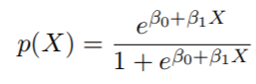
Logistic Regression Formulation
Let’s consider a dependent variable X, and a categorical target variable Y that takes two values 1 and 0 and write p(X) = Pr(Y = 1|X) for short. Logistic regression uses the form
Note that e ≈ 2.71828 is a mathematical constant [Euler’s number.]
It is easy to see that no matter what values β0, β1 or X take, p(X) will have values between 0 and 1
Notes:
Another way to describe the chance of an event occurring is with odds. The odds in favor of an event is the ratio that compares the number of ways the event can occur to the number of ways that the event could not occur. We can define the odds in favor of an event as the ratio of the number of favorable outcomes to the number of unfavorable outcomes.

Slide 5
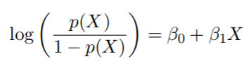
Logistic Regression Formulation
A bit of rearrangement gives
This monotone transformation is called the log odds or logit transformation of p(X).
Log transformation can help prevent numerical instability of the original formulation
Notes:
Using the logarithmic function, we can change the presentation of the previous formulation slightly. So, in this case we can write logarithm of the p(X) divided by 1 minus p(X) is equal to Beta 0 plus B1X. On the left-hand side we have the log odds or the logit transformation of p(X). this log transformation is usually very helpful to prevent numerical instability when we calculate the optimization.

Slide 6
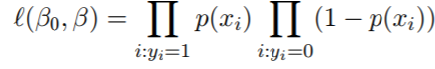
Logistic Regression Formulation
We use maximum likelihood to estimate the parameters.
This likelihood gives the probability of the observed zeros and ones in the data. We pick β0 and β to maximize the likelihood of the observed data.
Most statistical packages can fit linear logistic regression models by maximum likelihood. In R we use the glm() function.
The coefficient, β, in the logistic regression can be interpreted as follows. For every unit increase in X, the logarithm of the odd ratios of the Y increases by β.
Notes:
Now that we have expressed the likelihood function based on the parameter Beta 0 and Beta, our task is to find the optimal values of Beta 0 and Beta, such that to maximize the likelihood or the probability of the observed zero and one in the data given the parameters of the model. Most statistical packages can fit linear regression models by maximizing the likelihood and finding the optimal values of beta 0 and beta. In R we use the glm function to do that. The rule of the coefficient Beta and the logistic regression can be described as follows, for every unit in increase of X, the logarithm of the odds of the ratio of Y increases by Beta. So obviously as you can see, this interpretation is not as intuitive as the linear regression that we had before. However, because the log of the odds is still a monitoring function, you can interpret the sign of the coefficient the same way we have been doing for the linear regression models. In other words, if the Beta value is positive, we can say that increasing the value of X results in increasing the probability of Y being equal to one. Beta 0 on the other hand is a constant and does not play a significant role.

Slide 7
Example
library(ISLR)
Model=glm(default ~ balance, data=Default, family = 'binomial' ) summary(Model)
## ## Call: ## glm(formula = default ~ balance, family = "binomial", data = Default) ## ## Deviance Residuals: ## Min 1Q Median 3Q Max ## -2.2697 -0.1465 -0.0589 -0.0221 3.7589 ## ## Coefficients: ## Estimate Std. Error z value Pr(>|z|) ## (Intercept) -1.065e+01 3.612e-01 -29.49 <2e-16 *** ## balance 5.499e-03 2.204e-04 24.95 <2e-16 *** ## --- ## Signif. codes: 0 '***' 0.001 '**' 0.01 '*' 0.05 '.' 0.1 ' ' 1
Notes:
Let’s have a look of the implementation of the logistic regression in R. As we said before, we use the generalized linear model or glm for short, to construct linear regression models. Glm is very similar to lm models, however we need to additionally define an extra parameter called family. Now we want to consider the credit card default example as we have before. The default data set is part of the ISLR package, so the first thing is to load the ISLR package. So, we have the library ISLR and then we build the model as model is equal to glm, default is the name of the variable that we want to predict, and we want to use the balance of the credit card to predict the default. So, we say glm default against balance, data set is the default and now we define the family as binomial. When the family is defined as binomial, we define the logistic regression as trying to predict the target variable Y that has only two levels. In our case, default has two levels of yes and no. We can look at the summary of the model, again we can see the residual distribution and also the coefficients. Under the coefficient, the most important columns are the estimates and the p values. So, the estimate is actually the estimate of the coefficient values. So, for the balance we can see that this value is positive. This makes sense because as we have seen before, the increase in balance results in higher probability of default. We can also see the p values associated to both coefficients. In here both p values are very small, suggesting that coefficients that are calculated, both for the balance and the constant are statistically significant.

Slide 8
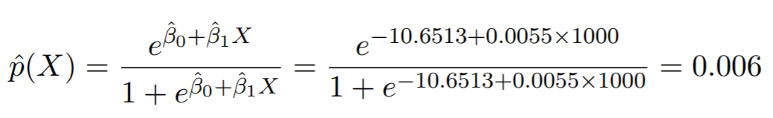
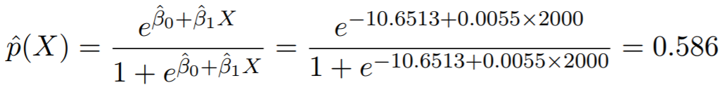
Making Predictions
What is our estimated probability of default for someone with a balance of $1000?
With a balance of $2000?
Notes:
Once we have our model calculated, we can use the model to make predictions. In fact, the idea of making any model is to use that model to make predictions. In this case the model parameter Beta 0 and B1 has been computed. So, in order to calculate the probability for a given observation, all what we need to do is to plot the numbers and calculate the probabilities. In our example, let’s assume that we want to estimate the probability of default for someone with a balance of 1000 dollars. In that case we can easily calculate the estimated probability of default by plugging Beta 0 and B1 into the formula. The result probability is 0.006, which is very small. Now, let’s consider a case when the balance is increased to 2000 dollars. We can see the default probability has increased to 0.58, which is significantly higher. This was expected since increasing the balance would result in the increase in the probability of default as we have seen before.

Slide 9
Example
library(ISLR)
## Warning: package 'ISLR' was built under R version 3.4.4
Model=glm(default ~ balance, data=Default, family = 'binomial' ) predict(Model, data.frame(balance=c(1000,2000)), type = "response") #returns probabilities
## 1 2 ## 0.005752145 0.585769370
predict(Model, data.frame(balance=c(1000,2000)), type = "link") #returns log-odds
## 1 2 ## -5.1524137 0.3465032
Notes:
Now let’s look at the implementation of the prediction function in R. similar to linear regression, we can use the predict function, and apply the predict function to the model in order to calculate the probability. So, in this case we use the same example, we use the ISLR library to load the default data set, we will then use the glm function to build the logistic regression model, to predict default based on the balance. Then we apply the predict function to the model. If you recall, the input to the predict function needs to be data frame. So, in that case we need to convert balance into the data frame. So, we have Predict parenthesis model, and then we have data dot frame balance equal to 1000 and 2000. There is an additional parameter here, which is type, If, type is set to respond, the predict function returns back the probabilities. However, if the type is set to link, the predict function returns the log of the odds. Since probabilities are more intuitive, it is more common to use type as a response. So, in this case we can see that the predictive probabilities are exactly the same as calculated in the previous slide. For the first observation where the balance was 1000, the probability is 0.0057 and for the second case where the balance was 2000 the probability is 0.58.

Slide 10
Example
library(ISLR)
## Warning: package 'ISLR' was built under R version 3.4.4
Model=glm(default t~ student, data=Default, family = 'binomial' ) summary(Model)
## ## Call: ## glm(formula = default ~ student, family = "binomial", data = Default) ## ## Deviance Residuals: ## Min 1Q Median 3Q Max ## -0.2970 -0.2970 -0.2434 -0.2434 2.6585 ## ## Coefficients: ## Estimate Std. Error z value Pr(>|z|) ## (Intercept) -3.50413 0.07071 -49.55 < 2e-16 *** ## studentYes 0.40489 0.11502 3.52 0.000431 ***
Notes:
Now let’s consider another example and build a model to predict the default based on the student status. In this case we can say model is equal to glm default against student and the data set is the same as the default, family is binomial. If we look at the summary of the model, we can see the coefficients as intercept and student yes. This is very similar to the situation that we have with the linear regression models. For categorical variables such as a student, the model picks one of the levels of the categorical variable and used that as a default and provides additional information as to how that can be adjusted based on the other levels. In that case student no has been used as a default and we can see how the coefficient can be changed if the student status was yes. So, we can see a statistic yes as corresponding to the estimate coefficient which is positive. This implies that if the student static is yes, there is a higher probability of default for the applicants.

Slide 11
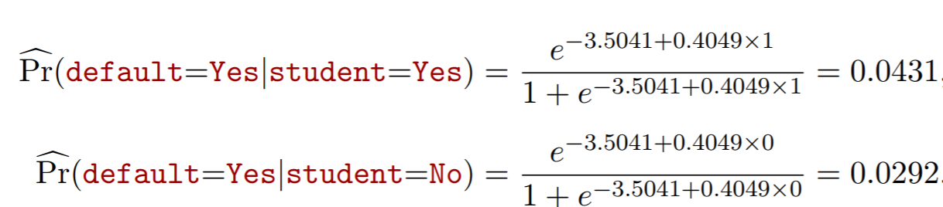
Example
library(ISLR)
## Warninglibrary(ISLR)
## Warning: package 'ISLR' was built under R version 3.4.4
Model=glm(default~ student, data=Default, family = 'binomial' ) predict(Model, data.frame(student=c("Yes", "No")), type = "response") #returns probabilities
## 1 2 ## 0.04313859 0.02919501
Notes:
We can use the predict function to confirm that the student’s status results in a higher probability of default. In this case, after we build a model, we can use the predict function, and use the data frame for prediction, we choose the event status, the first student status is yes and the second student status is no. We set the type to response so that we can get the probabilities. As we can see the probability associated to a student status being one is equal to 0.04 or approximately four percent whereas the probability of default associated to a student status no is approximately three percent. We could also use the formula to calculate the same probabilities as you can see below.

Slide 12
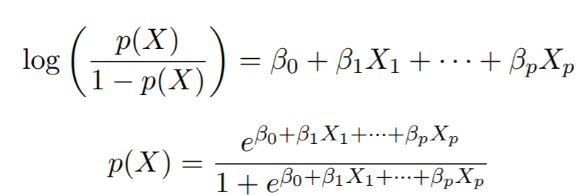
Multivariate Logistic Regression
Same principles as univariate models.
Notes:
Now, let’s consider multivariate logistic regression, where instead of having only one single variable to predict the target, we might have several variables. Same principal can be applied where the log of the odds of the target variable can be calculated as a linear combination of all the variables. So in this case, instead of only having Beta 0 and Beta 1, we have Beta 0, Beta 1, Beta 2, and Beta 3 up to the number of variables that we have.

Slide 13
Example
library(ISLR)
Model=glm(default~student + income + balance ,data=Default, family = 'binomial' ) summary(Model)
## Call: ## glm(formula = default ~ student + income + balance, family = "binomial", ## data = Default) ## ## Deviance Residuals: ## Min 1Q Median 3Q Max ## -2.4691 -0.1418 -0.0557 -0.0203 3.7383 ## ## Coefficients: ## Estimate Std. Error z value Pr(>|z|) ## (Intercept) -1.087e+01 4.923e-01 -22.080 < 2e-16 *** ## studentYes -6.468e-01 2.363e-01 -2.738 0.00619 ** ## income 3.033e-06 8.203e-06 0.370 0.71152 ## balance 5.737e-03 2.319e-04 24.738 < 2e-16 *** ## ---
Notes:
Now, let’s build a logistic regression model that uses several variables. In this case again we use the default data set, which is a part of the ISLR library. However, we try to predict the default using the student status income and balance altogether. So, we have model equal to glm default against student plus income plus balance, data is the default, and the family is binomial. If we look at the summary of the model, we can see the intercept, we can see the student status yes, income balance, and the estimate of the coefficient for each of them as well as the p value for each of the variables. One thing that you might have noticed, is that now that we have included income and balance, the coefficient for the student status yes has changed to negative. Before student status of yes was associated with a higher probability of default. Now we can see that the coefficient for this variable has changed to negative.

Slide 14
Confounding
Students tend to have higher balances than non-students, so their marginal default rate is higher than for non-students.
But for each level of balance, students default less than non-students.
Multiple logistic regression can tease this out.
Notes:
The reason that the sign of the coefficient for the student status variable was changed is related to what is so called the confounding effect.
Confounding variables are often defined as variables that correlate with both the dependent variable and the independent variables. In other words, a confounder is a variable whose presence affects the variables being studied so that the results do not reflect the actual relationship between the variables under study. In the previous example, students tend to have higher balances than non-students, so their marginal default rate is higher than for non-students. But for each level of balance, students default less than non-students. As a result, without the presence of the balance variable, student status was shown to have a positive correlation with with default,
To avoid confounding you should make sure you identify all of the possible confounding variables in your study. Make a list of every variable you can think of and one by one, consider whether those listed items might influence the outcome of your study.

Slide 15
Confounding
High Balance
Student
Credit Card Default
Notes:
Here is a simple graphical representation of the previous example. As we can see here, student status does not relate directly to the credit card default. However, being a student corresponds to a higher balance, and a higher balance results in higher credit card default rates.

Slide 16
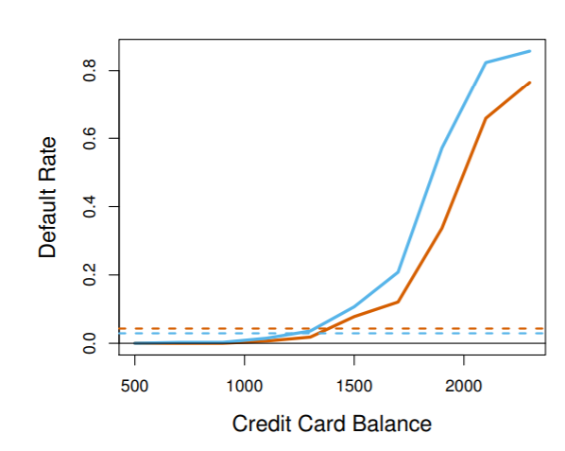
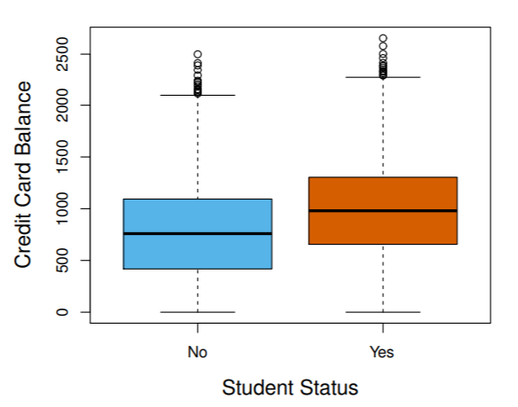
Example
library(ISLR)
library(dplyr)
Default %>% group_by(student) %>% summarise(Defualt_Rate=mean(default=="Yes"))
## # A tibble: 2 x 2 ## student Defualt_Rate ## <fct> <dbl> ## 1 No 0.0292 ## 2 Yes 0.0431
Default %>% group_by(student) %>% summarise(Mean_Balance=mean(balance))
## # A tibble: 2 x 2 ## student Mean_Balance ## <fct> <dbl> ## 1 No 772 ## 2 Yes 988
Notes:
Here is the code, and two visual representations that can help better understand the previous example. So, as we can see, if you use the group by and look at the relationship between the default rate and student status, we can group by the default data set by the student status and calculate the mean of the default rate for each of the categories. So, in this case, we can see that for student status no, the default rate is nearly three percent, whereas when the student status is yes, the default rate increases to nearly 4.3 percent. However, if we group by the student status by the balance, we already see that the student status yes corresponds to a higher balance as well. This is clearly shown in the bottom graph. As we can see, the credit card balance is higher when the student status is yes. As a result, if you do not include the balance in the model, the model might think it just because of the student status that the default rate is higher.

